Slide 1

Supporting patients who are dependent on opioids is now easier than ever…

Slide 2

...and GPs are ideally placed to support patients with low to moderate dependence...

Slide 3

ODT medications are now easier to prescribe and are more affordable, convenient and accessible for your patients.
What’s new?

Slide 4

Extra support and collaborative care arrangements can be provided by your local public Alcohol and Drug Service.

Slide 5
A range of digital and print resources are now available from your PHN, including…

Slide 6
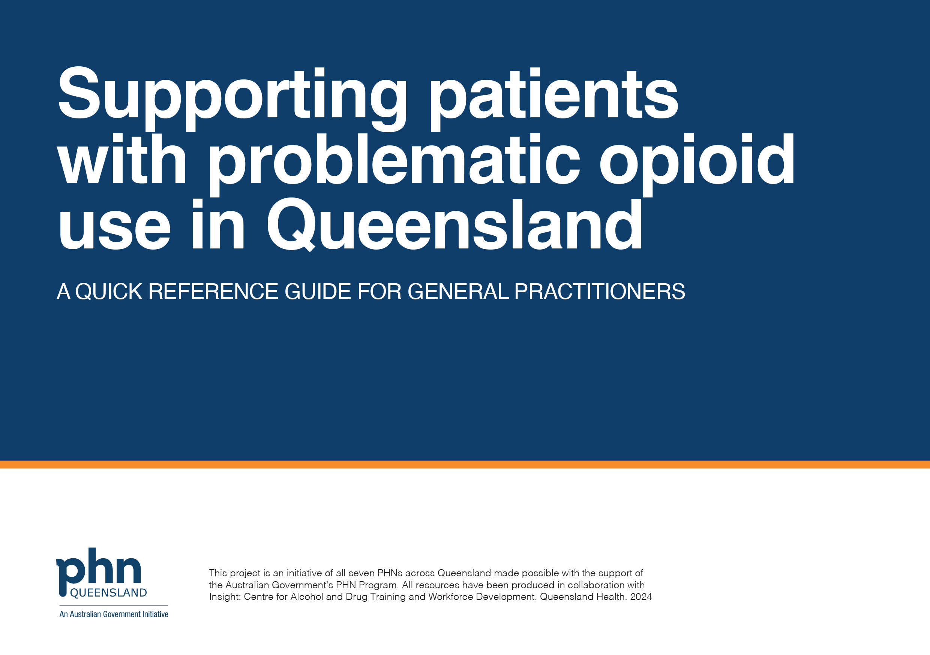
A quick reference guide on opioid dependence treatment options…

Slide 7
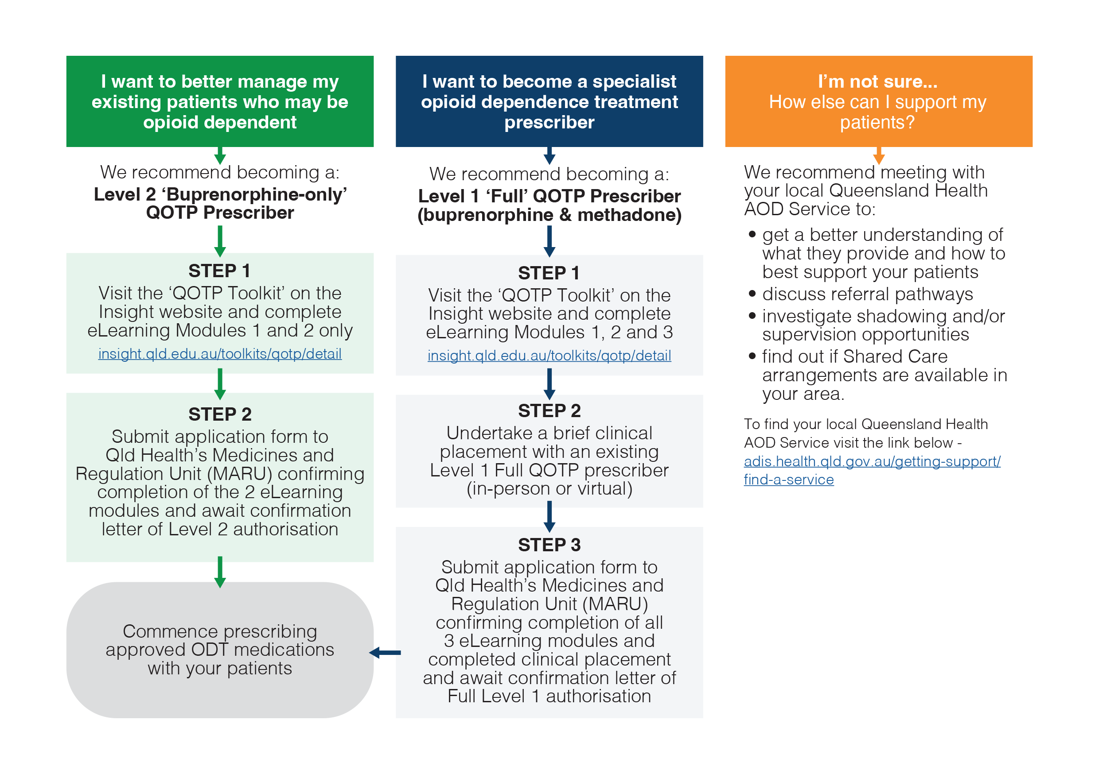
A handy flowchart outlining your management options…

Slide 8
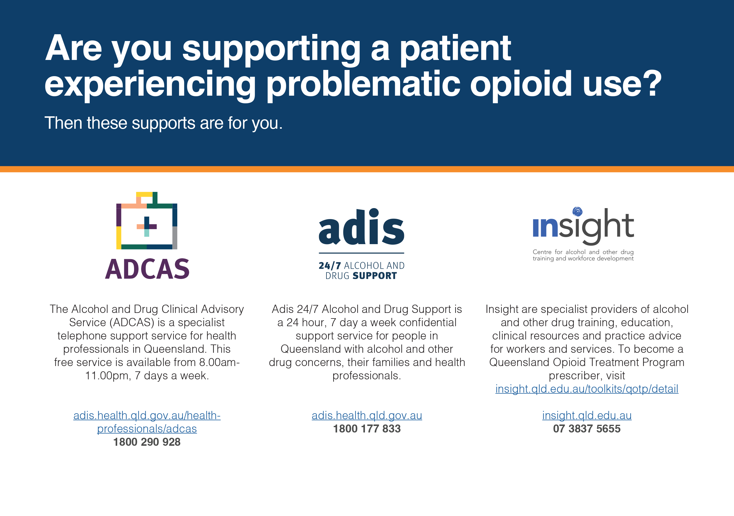
Support at your fingertips...

Slide 9

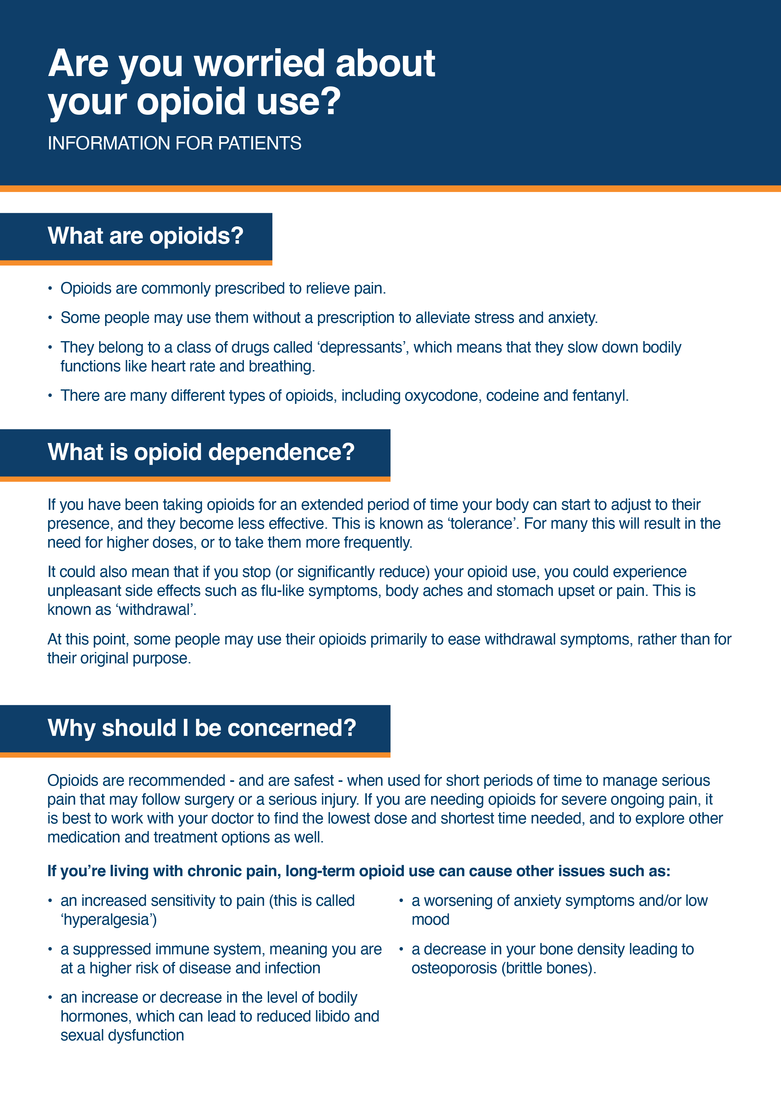

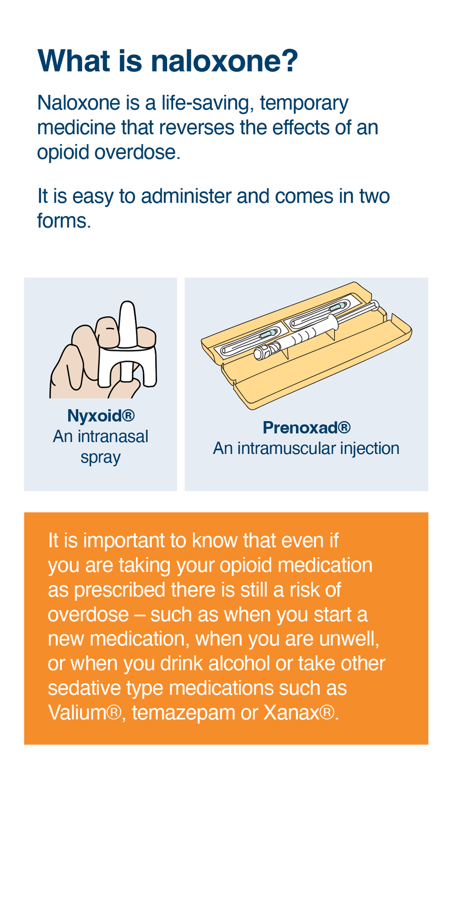
Patient information materials…

Slide 10


Long acting injection buprenorphine medication demonstration video - suitable for all clinical staff.

Slide 11

Engaging and managing patients - with support from specialist AOD services - benefits everyone.

Slide 13

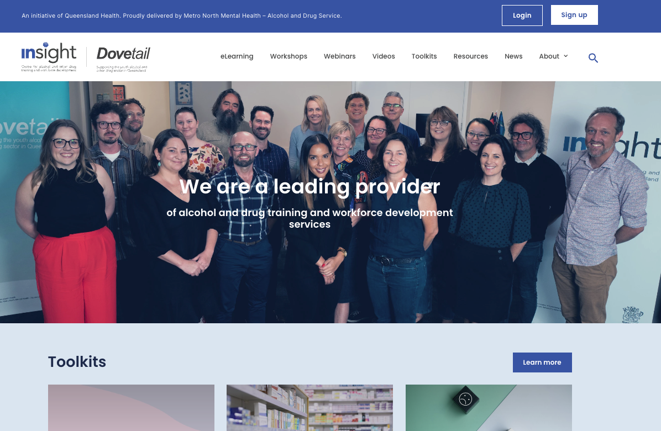
You can find these resources and more on the Insight website.
insight.qld.edu.au/toolkits/odt-gptoolkit/detail

Slide 14
ODT medications are now subsidised through the Pharmaceutical Benefits Scheme (PBS), making them affordable for patients.
Good news!

Slide 15

There are no extra patient charges for consultation, administration, dosing or dispensing at community pharmacies.
Did you know that...
Good news!

Slide 16

Telephone-based clinical advice with Addiction Medicine Specialists is available 7-days a week in Queensland.
Good news!

Slide 17

The process for GPs to become authorised to prescribe ODT medications in Queensland has been simplified.
Did you know that...
Good news!

Slide 18
You can enter into a collaborative care arrangement with your local public AOD service to co-support your patient.
Did you know that...
Good news!

Slide 19
Supporting patients who are dependent on opioids is now easier than ever…

Slide 20


These resources are an initiative of all seven PHNs across Queensland made possible with the support of the Australian Government's PHN Program.
All resources have been produced in collaboration with Insight: Centre for Alcohol and Drug Training and Workforce Development, Queensland Health.

